Slide 1

32555 – Fundamentals of Software Development

Slide 2
Welcome to 32555 – Fundamentals of Software Development
Your Teaching Team:
Dr. Yining Hu | Subject Coordinator
Yining is a Lecturer in Software Engineering. She works with many SMEs to develop software and AI solutions through student and research projects at UTS.
Contact: yining.hu@uts.edu.au
Dr. Xiaojie (Zoe) Lin | Tutor
Zoe is a full-stack software engineer with an interest in data analysis, specializing in JAVA, R, Python, JavaScript, PHP, Bash, and MATLAB; familiar with AWS.
Contact: Xiaojie.Lin@uts.edu.au
Dr. Farshid Keivanian | Tutor
Dr. Farshid Keivanian is an experienced university lecturer and researcher with a PhD in Information Technology. He has over 15 years of teaching experience across Australian institutions, specialising in software engineering, data science, AI, and cybersecurity.
Contact: Farshid.Keivanian@uts.edu.au
Yong Pov | Tutor
Yong is a full-stack software engineer with experience in React, JavaScript, TypeScript, Java, Python, SQL, and AI-assisted learning platforms.
Contact: Yong.Pov@uts.edu.au

Slide 3
Welcome to 32555 – Fundamentals of Software Development
Cmp1 # | Location | Time | Tutor
01 | CB11.B1.400 | Fri 16:00-18:00 | Xiaojie (Zoe) Lin
07 | CB11.B1.401 | Wed 10:00-12:00 | Farshid Keivanian
08 | CB11.B1.400 | Fri 12:00-14:00 | Yong Pov
09 | CB11.B1.103 | Wed 16:00-18:00 | Farshid Keivanian
10 | CB11.B1.401 | Wed 12:00-14:00 | Farshid Keivanian

Slide 4
Class Diagram Practice
Goal
By the end of this lab, students should be able to:
Identify classes, attributes, methods from a case description.
Draw associations with multiplicity.
Use generalization/specialization (inheritance).
Design a small class diagram that mirrors the complexity of their group assignment.

Slide 5
Class Diagram Practice
Example 1 – Scenario: Library System
Scenario (mini case study)
A Library has many Books.
The Library has name and address
Library
Attributes: name, address
Relationships:
has many Books → 1..*

Slide 6
Class Diagram Practice
Each Book can be borrowed by one Member at a time.
Each book has title, isbn, status.
Book
Attributes: title, isbn, status
Relationships:
Borrowed by one Member at a time → 0..1

Slide 7
Class Diagram Practice
Members can borrow maximum 5 books.
Each member has id, name, email.
Member
Attributes: id, name, email
Constraints:
Can borrow maximum 5 books → 0..5
Operations:
borrow(Book)
return(Book)

Slide 8
Class Diagram Practice
(1, 1)
(1, M)
Library
Books
Library “has many” Books (1..*).
Library 1.. → Book*
This means one library must have at least one book (and usually many).
Example: The City of Sydney Library has thousands of books, not zero books.

Slide 9
Class Diagram Practice
(1, 1)
(1, M)
Library
Books
Library “has many” Books (1..*).
Each Book belongs to exactly one Library
Every book is stored in one library only.
Example: The book Harry Potter in the Kogarah Library is not also in the North Sydney Library’s system at the same time. Each copy belongs to one library.

Slide 10
Class Diagram Practice
(0, 1)
(0, 5)
Member
Books
Each Book can be borrowed by 0 or 1 Member at a time
A book is either not borrowed (0) or borrowed by one member (1).
Example: If John borrows The Hobbit, no other member can borrow that same copy until John returns it.

Slide 11
Class Diagram Practice
(0, 1)
(0, 5)
Member
Books
Member 0..5 → Book
A member can borrow between 0 and 5 books at a time.
Example: Armin joins the library. Right now, he may borrow no books (0), or maximum 5 books, but not more.

Slide 12
Class Diagram Practice
(1, 1)
(1, M)
Library
Book
has
title
In short:
A library owns many books.
A member can borrow minimum 0 and maximum 5 books.
A book belongs to only one library.
A book can be borrowed by only one member at a time (or by no one if it’s on the shelf).
borrow() and return() are shown as operations in the Member class.
name
isbn
address
status
(0, 5)
(0, 1)
Member
Borrowed by
id
name
email
Borrow(Book)
Return(Book)

Slide 13
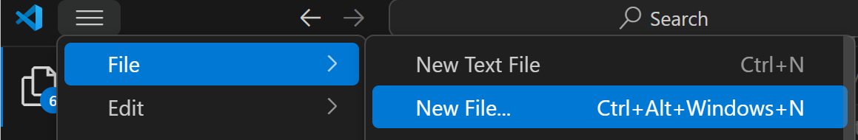
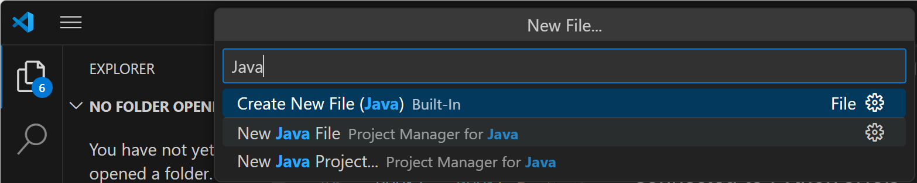
From UML Diagram to Code: Library Example (Java)

Slide 14
From UML Diagram to Code: Library Example (Java)
import java.util.ArrayList;
import java.util.List;
class Book {
String title;
String isbn;
String status = "available"; // "available" or "borrowed"
Member borrowedBy = null; // which Member has borrowed it
Book(String title, String isbn) {
this.title = title;
this.isbn = isbn;
}
}
(1, 1)
(1, M)
Library
Book
has
title
name
isbn
address
status
(0, 5)
(0, 1)
Book
Keeps the title, ISBN, whether it’s available or borrowed, and (if borrowed) which member has it.
Member
Borrowed by
id
name
email
Borrow(Book)
Return(Book)

Slide 15
From UML Diagram to Code: Library Example (Java)
class Member {
int id;
String name;
String email;
List<Book> borrowedBooks = new ArrayList<>();
Member(int id, String name, String email) {
this.id = id;
this.name = name;
this.email = email;
}
(1, 1)
(1, M)
Library
Book
has
title
name
isbn
address
status
Member
Stores id, name, email, and a list of books they currently hold.
(0, 5)
(0, 1)
Member
Borrowed by
id
name
email
Borrow(Book)
Return(Book)

Slide 16
From UML Diagram to Code: Library Example (Java)
void borrow(Book book) {
if (borrowedBooks.size() >= 5) {
System.out.println(name + " cannot borrow more than 5 books.");
return;
}
if ("borrowed".equals(book.status)) {
System.out.println("Book '" + book.title + "' is already borrowed.");
return;
}
book.status = "borrowed";
book.borrowedBy = this;
borrowedBooks.add(book);
System.out.println(name + " borrowed '" + book.title + "'.");
}
void returnBook(Book book) {
if (borrowedBooks.contains(book)) {
borrowedBooks.remove(book);
book.status = "available";
book.borrowedBy = null;
System.out.println(name + " returned '" + book.title + "'.");
} else {
System.out.println(name + " does not have '" + book.title + "'.");
}
}
}
borrow(Book)
Blocks if the member already has 5 books.
Blocks if the book is already borrowed by someone else.
Otherwise, marks the book as borrowed, remembers who borrowed it, adds it to the member’s list, and prints a message.

Slide 17
From UML Diagram to Code: Library Example (Java)
void borrow(Book book) {
if (borrowedBooks.size() >= 5) {
System.out.println(name + " cannot borrow more than 5 books.");
return;
}
if ("borrowed".equals(book.status)) {
System.out.println("Book '" + book.title + "' is already borrowed.");
return;
}
book.status = "borrowed";
book.borrowedBy = this;
borrowedBooks.add(book);
System.out.println(name + " borrowed '" + book.title + "'.");
}
void returnBook(Book book) {
if (borrowedBooks.contains(book)) {
borrowedBooks.remove(book);
book.status = "available";
book.borrowedBy = null;
System.out.println(name + " returned '" + book.title + "'.");
} else {
System.out.println(name + " does not have '" + book.title + "'.");
}
}
}
returnBook(Book)
If the member has that book, it removes it from their list, marks it available, clears the borrower, and prints a message.

Slide 18
From UML Diagram to Code: Library Example (Java)
class Library {
String name;
String address;
List<Book> books = new ArrayList<>();
Library(String name, String address) {
this.name = name;
this.address = address;
}
void addBook(Book book) {
books.add(book);
}
}
Library
Has a name, address, and a list of books, with a method to add books.

Slide 19
From UML Diagram to Code: Library Example (Java)
public class LibrarySystem_Java {
public static void main(String[] args) {
// --- Example usage (matches your Python flow) ---
Library library = new Library("Sydney Library", "123 George St");
Book book1 = new Book("Python Basics", "111");
Book book2 = new Book("Java Programming", "222");
library.addBook(book1);
library.addBook(book2);
Member member = new Member(1, "Farshid", "Farshid.Keivanian@uts.edu.au");
member.borrow(book1); // borrow success
member.borrow(book1); // already borrowed
member.returnBook(book1); // return success
}
}
main (in LibrarySystem_Java)
Creates a Library, some Books, one Member, then demo-borrows and returns.

Slide 20
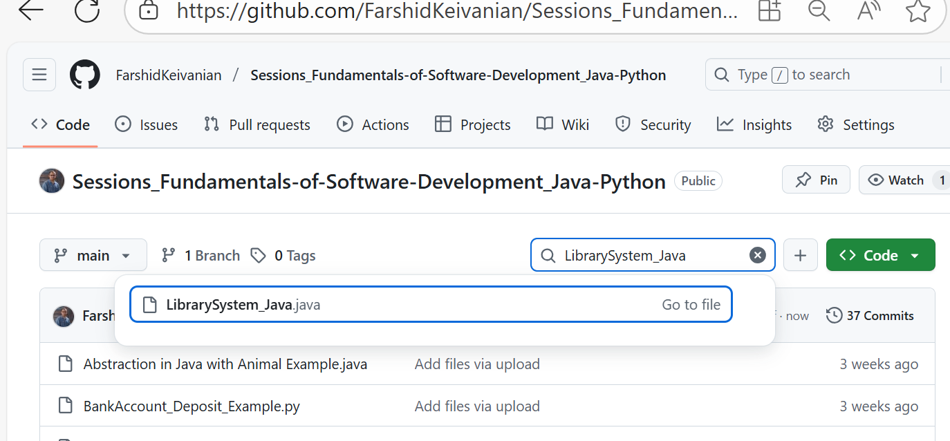
From UML Diagram to Code: Library Example (Java)
The Java code is also available on GitHub

Slide 21
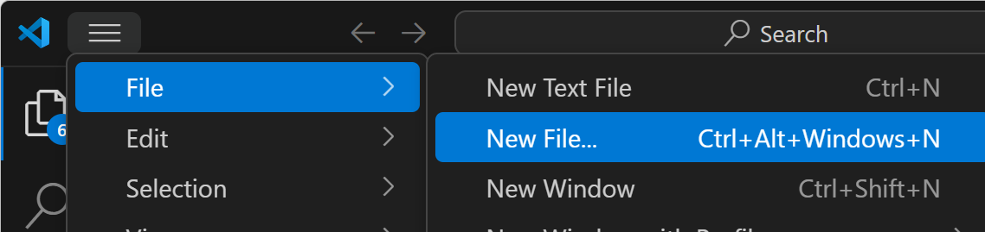
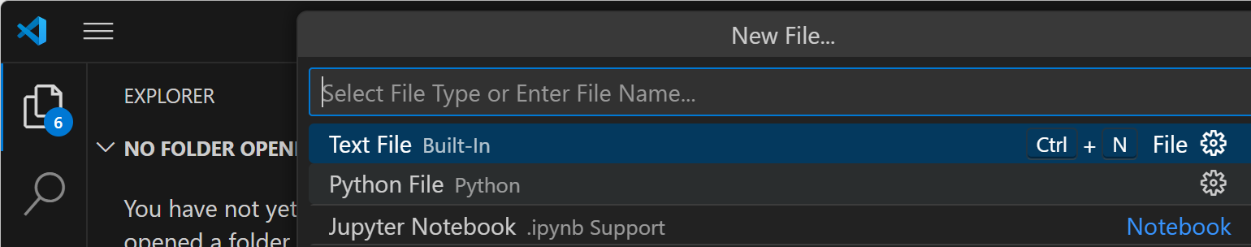
From UML Diagram to Code: Library Example (Python)

Slide 22
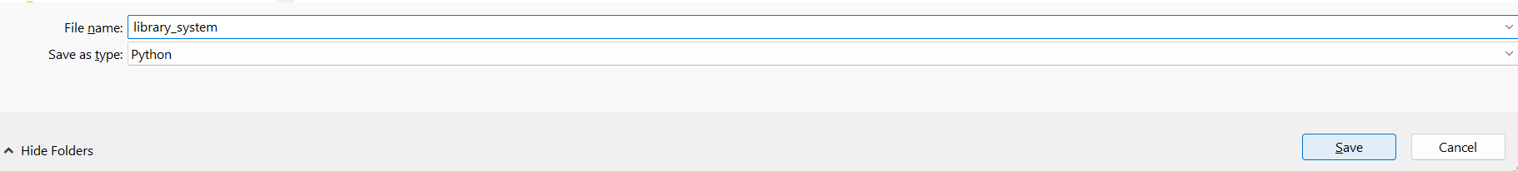
From UML Diagram to Code: Library Example (Python)
Save it as a library system:
library_system.py

Slide 23
class Book:
def __init__(self, title, isbn):
self.title = title
self.isbn = isbn
self.status = "available" # available or borrowed
self.borrowed_by = None # which Member has borrowed
(1, 1)
(1, M)
Book class
Has a title, isbn, and status (available or borrowed).
Keeps track of who borrowed it (borrowed_by).
Library
Book
has
title
name
isbn
address
status
(0, 5)
(0, 1)
Member
Borrowed by
id
name
email
Borrow(Book)
Return(Book)

Slide 24
class Member:
def __init__(self, member_id, name, email):
self.id = member_id
self.name = name
self.email = email
self.borrowed_books = []
Member class
Has an id, name, email.
Can borrow up to 5 books.
borrow(book) → checks if the member already has 5 or if the book is taken.
return_book(book) → removes the book from their list and makes it available again.
(1, 1)
(1, M)
Library
Book
has
title
name
isbn
address
status
(0, 5)
(0, 1)
Member
Borrowed by
id
name
email
Borrow(Book)
Return(Book)

Slide 25
def borrow(self, book):
if len(self.borrowed_books) >= 5:
print(f"{self.name} cannot borrow more than 5 books.")
return
if book.status == "borrowed":
print(f"Book '{book.title}' is already borrowed.")
return
book.status = "borrowed"
book.borrowed_by = self
self.borrowed_books.append(book)
print(f"{self.name} borrowed '{book.title}'.")
(1, 1)
(1, M)
Library
Book
has
title
name
isbn
address
status
(0, 5)
This method lets a member borrow a book only if they haven’t reached the 5-book limit and the book isn’t already taken.
(0, 1)
Member
Borrowed by
id
name
email
Borrow(Book)
Return(Book)

Slide 26
def borrow(self, book):
if len(self.borrowed_books) >= 5:
print(f"{self.name} cannot borrow more than 5 books.")
return
if book.status == "borrowed":
print(f"Book '{book.title}' is already borrowed.")
return
book.status = "borrowed"
book.borrowed_by = self
self.borrowed_books.append(book)
print(f"{self.name} borrowed '{book.title}'.")
(1, 1)
(1, M)
Library
Book
has
title
name
isbn
address
status
What does borrow(self, book) do?
Check limit → If the member already has 5 books, stop and show a message.
Check book status → If the book is already borrowed by someone else, stop and show a message.
Update book → Mark the book as "borrowed" and record that this member has it.
Update member → Add the book to the member’s borrowed list.
Confirm → Print a message that the member successfully borrowed the book.
(0, 5)
(0, 1)
Member
Borrowed by
id
name
email
Borrow(Book)
Return(Book)

Slide 27
def return_book(self, book):
if book in self.borrowed_books:
self.borrowed_books.remove(book)
book.status = "available"
book.borrowed_by = None
print(f"{self.name} returned '{book.title}'.")
else:
print(f"{self.name} does not have '{book.title}'.")
(1, 1)
(1, M)
What does return_book(self, book) do?
Check ownership → See if the book is in the member’s borrowed list.
If yes →
Remove the book from their list.
Mark the book as "available".
Clear who borrowed it (None).
Show a message confirming the return.
If no → Print a message saying the member never borrowed that book.
Library
Book
has
title
name
isbn
address
status
(0, 5)
(0, 1)
Member
Borrowed by
id
name
email
Borrow(Book)
Return(Book)

Slide 28
def return_book(self, book):
if book in self.borrowed_books:
self.borrowed_books.remove(book)
book.status = "available"
book.borrowed_by = None
print(f"{self.name} returned '{book.title}'.")
else:
print(f"{self.name} does not have '{book.title}'.")
(1, 1)
(1, M)
This method lets a member return a book they borrowed. If they never borrowed it, the system warns them.
Library
Book
has
title
name
isbn
address
status
(0, 5)
(0, 1)
Member
Borrowed by
id
name
email
Borrow(Book)
Return(Book)

Slide 29
class Library:
def __init__(self, name, address):
self.name = name
self.address = address
self.books = []
def add_book(self, book):
self.books.append(book)
(1, 1)
(1, M)
Library
Book
has
title
name
isbn
address
status
(0, 5)
(0, 1)
Member
Borrowed by
id
Library class
Has a name, address, and a list of books.
add_book(book) → puts new books into the library.
name
email
Borrow(Book)
Return(Book)

Slide 30
# --- Example usage ---
library = Library("Sydney Library", "123 George St")
book1 = Book("Python Basics", "111")
book2 = Book("Java Programming", "222")
library.add_book(book1)
library.add_book(book2)
member = Member(1, "Farshid Keivanian", "Farshid.Keivanian@uts.edu.au")
member.borrow(book1) # borrow success
member.borrow(book1) # already borrowed
member.return_book(book1) # return success
(1, 1)
(1, M)
Library
Book
has
title
name
isbn
address
status
(0, 5)
(0, 1)
Member
Borrowed by
Usage Example
Create a library.
Add some books.
Create a member.
Borrow and return books → see rules enforced (max 5, no double borrowing).
id
name
email
Borrow(Book)
Return(Book)

Slide 31
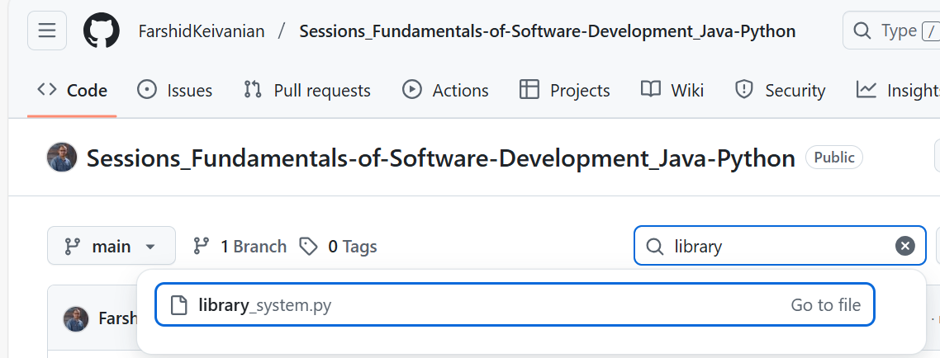
From UML Diagram to Code: Library Example (Python)
Code is also Available on GitHub (Please download it; we will have activities to extend it)
library_system.py

Slide 32
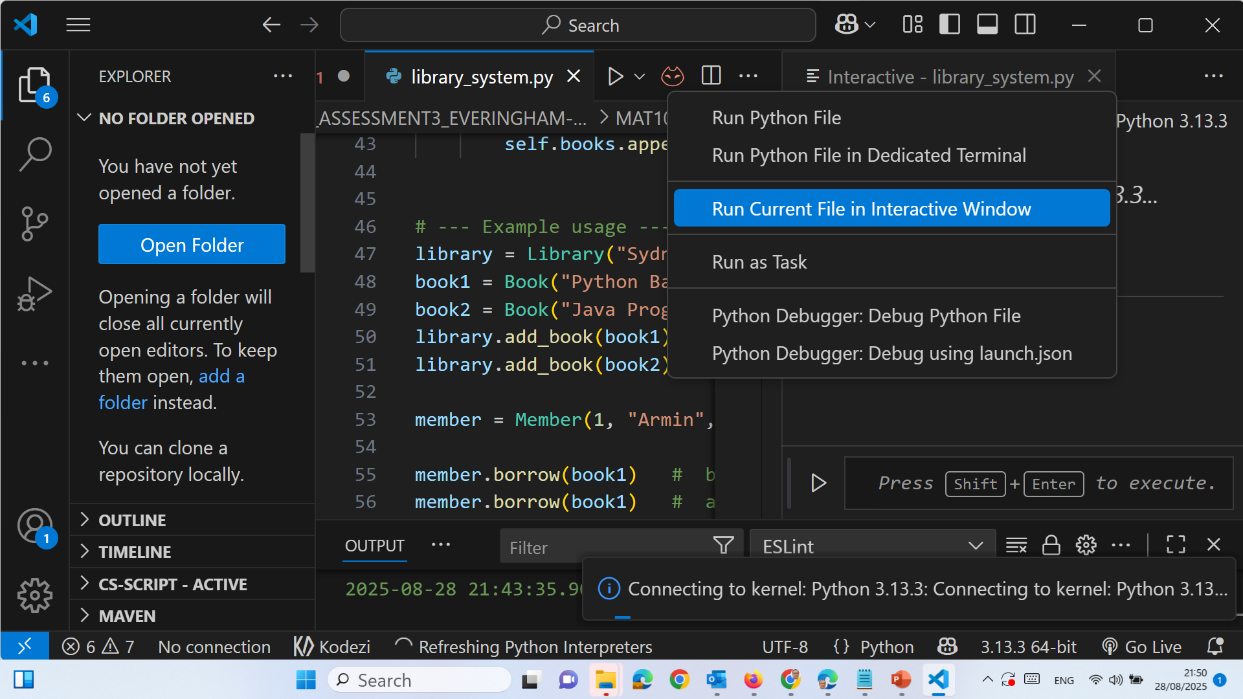
From UML Diagram to Code: Library Example (Python)

Slide 33
From UML Diagram to Code: Library Example (Python)
The Interactive Window option belongs to the Python extension + Jupyter extension in VS Code.
If you only see “Run in Terminal”, it means either:
The Jupyter extension is not installed, or
The file is not saved as .py, or
They haven’t selected the right Python interpreter / kernel.

Slide 34
From UML Diagram to Code: Library Example (Python)
Fix Steps:
Check the file extension
Save your file as something.py.
If it’s .txt or unsaved, VS Code won’t show Interactive Window.
Install the Jupyter extension
Go to the Extensions panel (Ctrl+Shift+X).
Search for “Jupyter” and install it (alongside Python extension).

Slide 35
From UML Diagram to Code: Library Example (Python)
Select Python interpreter
Press Ctrl+Shift+P → Python: Select Interpreter.
Choose the one where you installed Python (or Anaconda if using it).
Run with Interactive Window
Right-click inside the code editor → Run Current File in Interactive Window.
Or use the top-right “Run” menu.

Slide 36
From UML Diagram to Code: Library Example (Python)
In short:
If you don’t see Interactive Window, don’t panic. Save your file as .py, install the Jupyter extension, and pick the right Python interpreter. Then it will appear

Slide 37
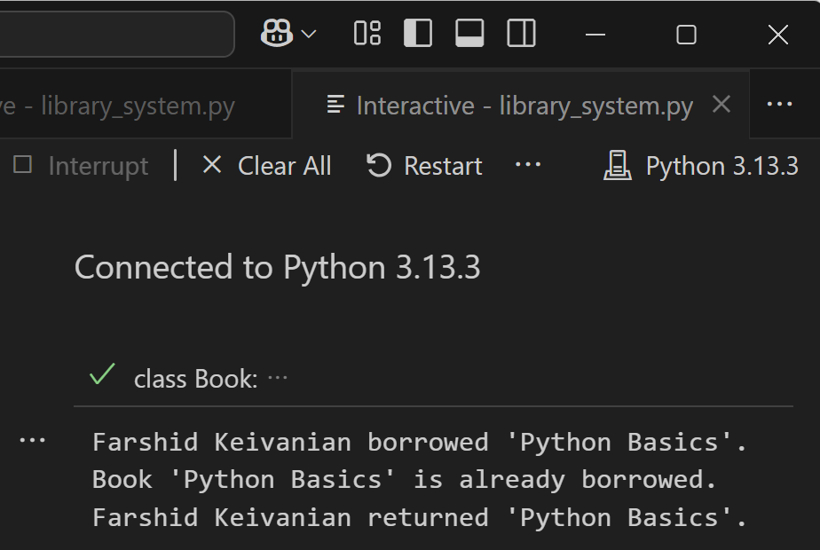
From UML Diagram to Code: Library Example (Python)
Farshid Keivanian borrowed 'Python Basics'.
The member successfully borrowed the book.
Conditions checked:
He had fewer than 5 books.
The book was available.
So the book’s status changed to borrowed, and it was added to his borrowed list.

Slide 38
From UML Diagram to Code: Library Example (Python)
Book 'Python Basics' is already borrowed.
The member tried to borrow the same book again.
The system detected the book’s status was already borrowed, so it blocked the action.

Slide 39
From UML Diagram to Code: Library Example (Python)
Farshid Keivanian returned 'Python Basics'.
The member returned the book successfully.
The book’s status changed back to available, and it was removed from his borrowed list.

Slide 40
From UML Diagram to Code: Library Example (Python)
Final State After Code Runs
Library: Still has the book.
Book ("Python Basics"): Available again (not borrowed by anyone).
Member (Farshid): Has no borrowed books.

Slide 41
From UML Diagram to Code: Library Example (Python)
In short: The code correctly enforces the borrowing rules:
Borrow once works.
Borrowing again is blocked.
Returning resets the book’s status.

Slide 42
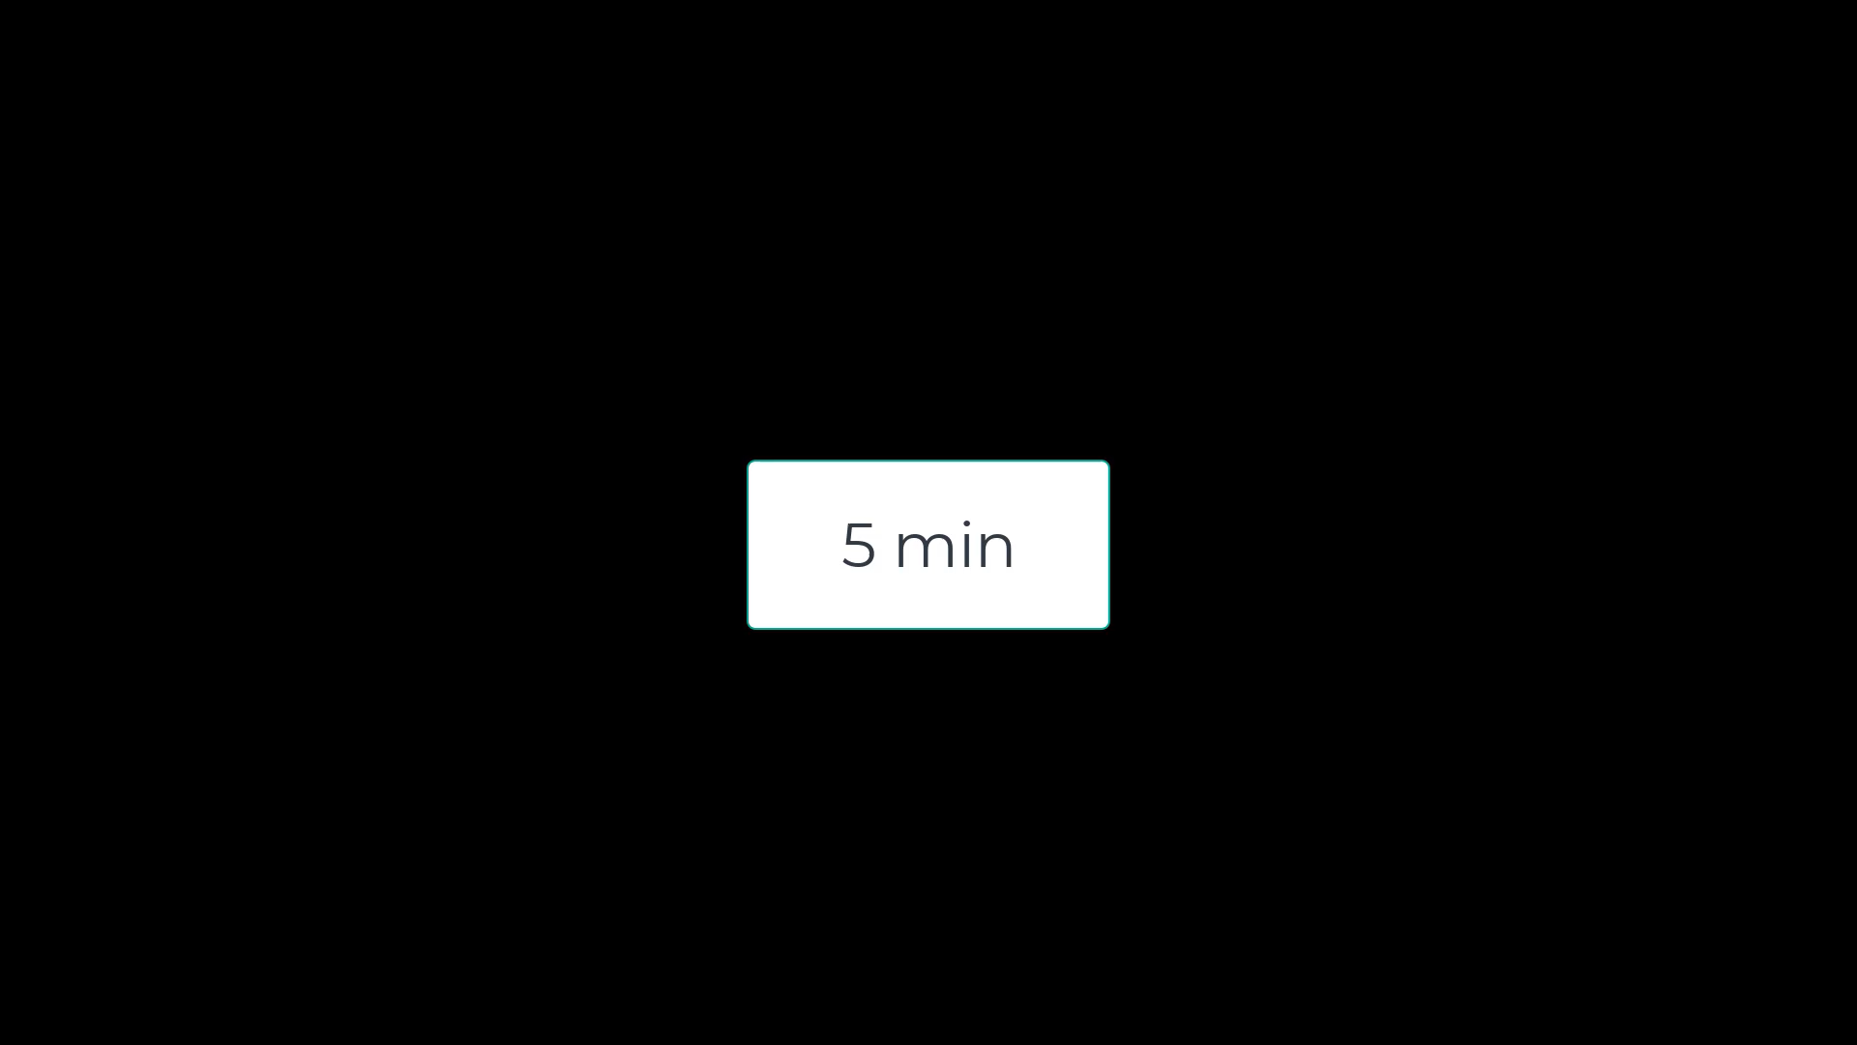
Activity 1 — Show the current count when limit blocks borrowing
Task: When a member hits the 5-book limit, show how many they already have. Hint for Python: Edit the first print(...) inside Member.borrow() where the limit is checked.
Hint for Java: Inside Member.borrow() in the limit check.

Slide 43
Activity 1 — Show the current count when limit blocks borrowing
print(f"{self.name} cannot borrow more than 5 books (currently {len(self.borrowed_books)}/5).")
For Python
len(self.borrowed_books) → this calculates the length of the list self.borrowed_books.
In other words, it counts how many books the member has borrowed right now.
Example: if the list has 3 books, then len(self.borrowed_books) = 3. Then the code prints it as: (currently 3/5) → which means 3 books out of the 5 allowed.

Slide 44
Activity 1 — Show the current count when limit blocks borrowing
(Java) Line 30:
if (borrowedBooks.size() >= 5) {
System.out.println(name + " cannot borrow more than 5 books.");
return;
}
System.out.println(name + " cannot borrow more than 5 books. You already have "
+ borrowedBooks.size() + " book(s).");

Slide 45
Activity 2 — Show total borrowed after a successful borrow
Task: After borrowing succeeds, print how many books the member now has. Hint for Python: Edit the last print(...) in Member.borrow() Class Member >> borrow method (success branch).
Hint for Java: At the end of the success branch in Member.borrow() (after borrowedBooks.add(book);).

Slide 46
Activity 2 — Show total borrowed after a successful borrow
print(f"{self.name} borrowed '{book.title}' (now {len(self.borrowed_books)} borrowed).")
This line prints a message when a member borrows a book.
{self.name} → shows the member’s name.
{book.title} → shows the book’s title.
{len(self.borrowed_books)} → counts how many books the member has borrowed so far.
In short: It tells who borrowed what book and how many books they now hold.

Slide 47
Activity 2 — Show total borrowed after a successful borrow
(Java) Line 41 of modified version:
System.out.println(name + " borrowed '" + book.title + "'.");
System.out.println(name + " borrowed '" + book.title + "'. Now holding "
+ borrowedBooks.size() + " book(s).");

Slide 48
Activity 3 — Show remaining count after a successful return
Task: After a return, display how many books the member still holds. Hint for Python: Edit the success print(...) inside Member.return_book(), where the if condition is true.
Hint for Java: Inside Member.returnBook() in the success part (inside the if (borrowedBooks.contains(book)) block), after you remove the book.

Slide 49
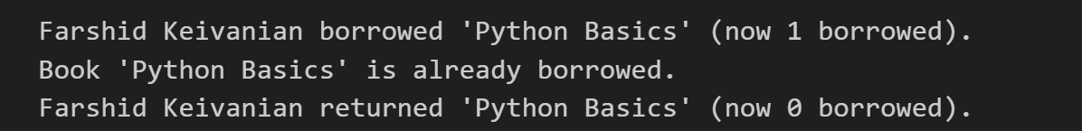
Activity 3 — Show remaining count after a successful return
print(f"{self.name} returned '{book.title}' (now {len(self.borrowed_books)} borrowed).")
(Python) When a member returns a book, this line prints:
Who returned it (self.name).
Which book was returned (book.title).
How many books they still have after the return (len(self.borrowed_books)).
Suppose Farshid had 3 books and returned Python Basics. It will print Farshid returned 'Python Basics' (now 2 borrowed).
Before return → 3 borrowed.
After return → 2 borrowed.

Slide 50
Activity 3 — Show remaining count after a successful return
(Java) Line 50 of modified version:
System.out.println(name + " returned '" + book.title + "'.");
System.out.println(name + " returned '" + book.title + "'. Now holding " + borrowedBooks.size() + " book(s).");
Note: borrowedBooks.size() already reflects the decreased count after remove(book).

Slide 51
Activity 4 — Track how many times a book has ever been borrowed
Task: Keep a running counter times_borrowed on each Book. Hint for Python: Add one new line in Member.borrow() right after setting book.borrowed_by = self (line 23), then display it
Hint for Java: Step 1 (new field): Add this inside class Book with the other fields (line 9).
int timesBorrowed = 0; // how many times this book has been borrowed (lifetime)
Step 2 (increment): In Member.borrow() after you mark the book borrowed and set the borrower, increment the counter.

Slide 52
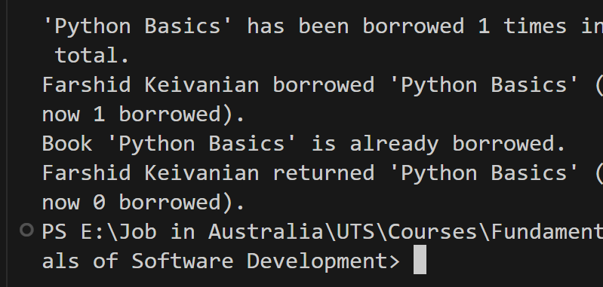
Activity 4 — Track how many times a book has ever been borrowed
book.times_borrowed = getattr(book, "times_borrowed", 0) + 1
print(f"'{book.title}' has been borrowed {book.times_borrowed} times in total.") # NEW line
(Python) If Farshid borrows Python Basics twice (with return in between):
Farshid borrowed 'Python Basics' (now 1 borrowed). 'Python Basics' has been borrowed 1 times in total. Farshid returned 'Python Basics' (now 0 borrowed). Farshid borrowed 'Python Basics' (now 1 borrowed). 'Python Basics' has been borrowed 2 times in total.

Slide 53
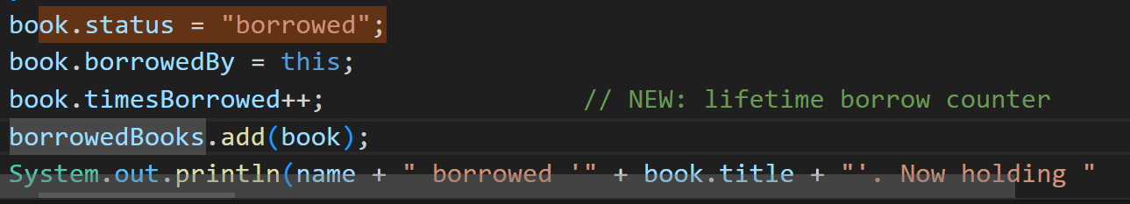
Activity 4 — Track how many times a book has ever been borrowed
(Java) line 9
int timesBorrowed = 0; // how many times this book has been borrowed (lifetime)
Class Member >> borrow – line 39
book.status = "borrowed";
book.borrowedBy = this;
borrowedBooks.add(book);

Slide 54
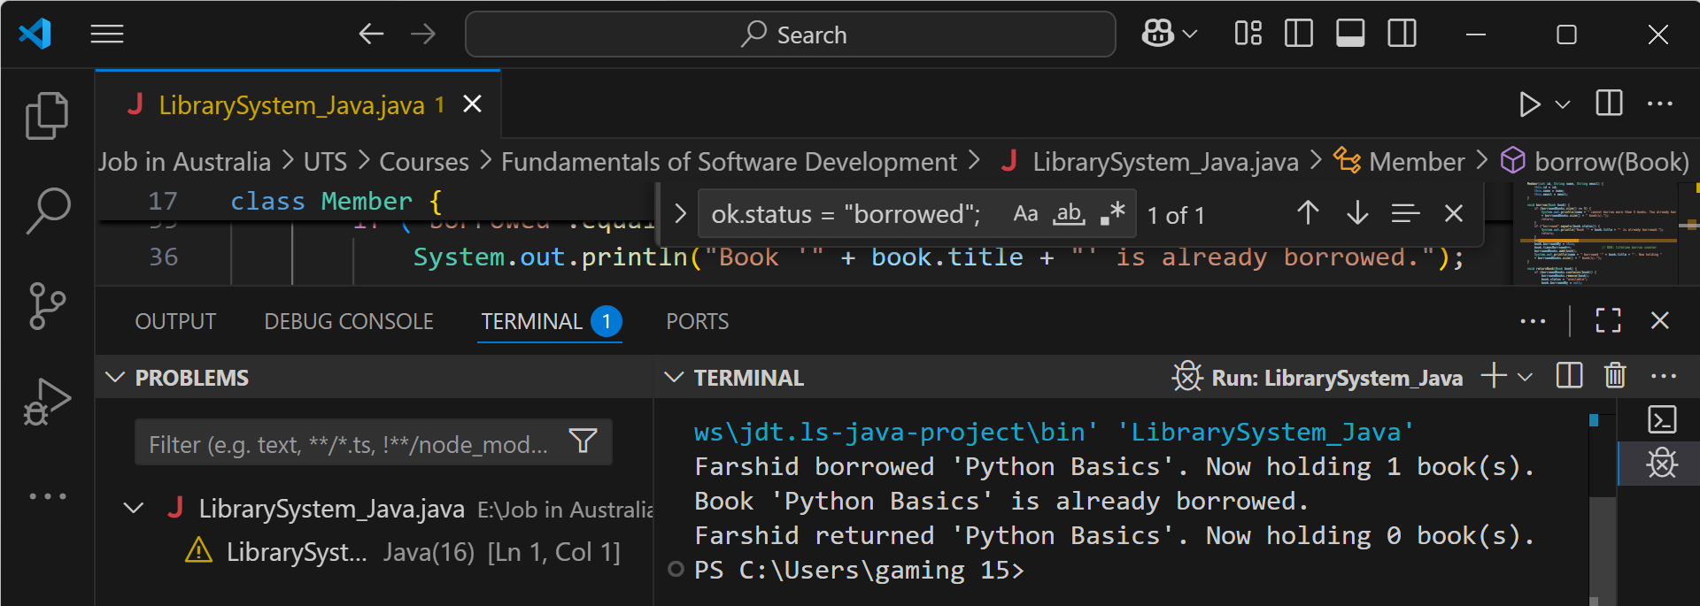
First borrow
borrow(book1) passed both checks (limit < 5, book available).
State changes:
book1.status = "borrowed"
book1.borrowedBy = Farshid
member.borrowedBooks.size() → 1
We see the Activity-2 message: “Now holding 1 book(s).”

Slide 55
Second borrow (same book)
if ("borrowed".equals(book.status)) triggered.
No state changes (book already with Farshid).
Correct error line printed: “Book 'Python Basics' is already borrowed.”

Slide 56
Return
returnBook(book1) found the book in borrowedBooks, removed it.
State changes:
book1.status = "available"
book1.borrowedBy = null
member.borrowedBooks.size() → 0
You see the Activity-3 message: “Now holding 0 book(s).”

Slide 57
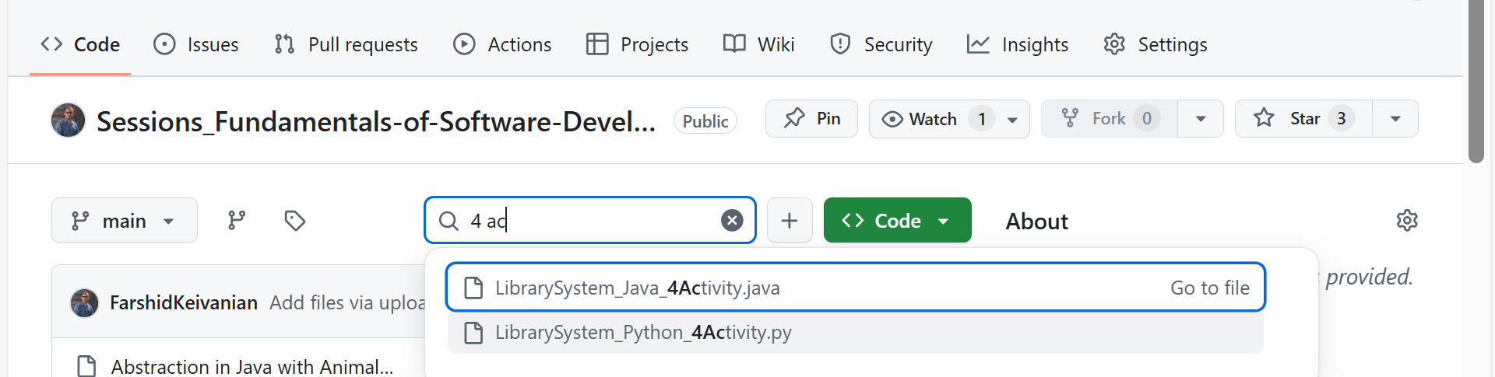
Activity 5 — Show who already has the book
First, download the complete file from GitHub and Apply these changes
Python and Java File Available on GitHub (With 4 Activities)

Slide 58
Activity 5 — Show who already has the book
Task: If borrowing is blocked because the book is taken, show the current borrower’s name.
Python — Hint: In Member.borrow(), in the if book.status == "borrowed": block, replace the print line.
print(f"Book '{book.title}' is already borrowed by {book.borrowed_by.name}.")
Java — Hint: In Member.borrow(), inside if ("borrowed".equals(book.status)) { ... }, replace the println.
System.out.println("Book '" + book.title + "' is already borrowed by " + book.borrowedBy.name + ".");

Slide 59
Activity 6 — Show remaining slots after a successful borrow
Task: After a successful borrow, also show how many slots remain (5 − current).
Python — Hint: In Member.borrow(), replace the success print(...) at the end of the success path.
print(f"{self.name} borrowed '{book.title}' (now {len(self.borrowed_books)}/5; {5 - len(self.borrowed_books)} left). This book has been borrowed {book.times_borrowed} time(s) in total.")
Java — Hint: In Member.borrow(), replace the success System.out.println(...) after borrowedBooks.add(book).
System.out.println(name + " borrowed '" + book.title + "' (now " + borrowedBooks.size() + "/5; " + (5 - borrowedBooks.size()) + " left). This book has been borrowed " + book.timesBorrowed + " time(s) in total.");

Slide 60
Activity 7 — When returning a book you don’t have, show who actually has it
Task: If the member tries to return a book they don’t hold, show the current holder (or “nobody”).
Python — Hint: In Member.return_book(), in the else: branch, replace the print line.
print(f"{self.name} does not have '{book.title}'. Currently with {book.borrowed_by.name if book.borrowed_by else 'nobody'}.")
Java — Hint: In Member.returnBook(), in the else branch, replace the println.
System.out.println(name + " does not have '" + book.title + "'. Currently with " + (book.borrowedBy != null ? book.borrowedBy.name : "nobody") + ".");

Slide 61
Activity 8 — Simple email sanity check on member creation
Task: Warn if the email looks invalid (no “@”).
Python — Hint: In Member.__init__, at the end of the constructor, add one line.
if "@" not in self.email: print(f"Warning: '{self.email}' may be invalid.")
Java — Hint: In Member constructor, at the end of the constructor, add one line.
if (!this.email.contains("@")) System.out.println("Warning: '" + this.email + "' may be invalid.");

Slide 62
Activity 9 — Tidy book titles on creation
Task: Normalise book titles when creating a Book (nice capitalisation).
Python — Hint: In Book.__init__, replace self.title = title.
self.title = title.title()
Java — Hint: In Book constructor, replace this.title = title;.
this.title = title.isEmpty() ? title : Character.toUpperCase(title.charAt(0)) + title.substring(1);

Slide 63
Activity 10 — Warn on duplicate ISBN when adding to the library
Task: If a book with the same ISBN already exists in the library, print a warning (still add it).
Python — Hint: In Library.add_book(), at the very top of the method, add one line.
if any(b.isbn == book.isbn for b in self.books): print(f"Warning: ISBN {book.isbn} already exists.")
Java — Hint: In Library.addBook(Book book), at the very top of the method, add one line.
if (books.stream().anyMatch(b -> b.isbn.equals(book.isbn))) System.out.println("Warning: ISBN " + book.isbn + " already exists.");

Slide 64
Reference Note for Students
The main reference for this assignment is the official instructions provided on Canvas.
This PowerPoint is designed to guide you and clarify the task where things might feel confusing. If you are ever unsure, please always go back to the official Canvas instructions as the source of truth.

Slide 65

Let’s Answer Your Questions
Canvas Inbox – For academic queries.
Email – For formal communication and attachments.
Canvas Discussion – For academic discussions and general queries.
Reminder – Please follow up if you do not receive a response within 3 business days.

Slide 66

Happy Learning and Bright Futures Ahead! Dr. Farshid Keivanian Stay Connected: linkedin.com/in/farshid-keivanian github.com/FarshidKeivanian
Education is the most powerful weapon you can use to change the world. — Nelson Mandela

